Slide 1
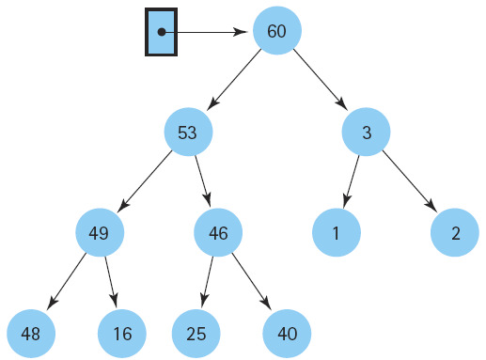
C++ and Data Structures &
Algorithms
Week 1 and Week 2

Slide 2
Atomic Variables
Atomic variables can only store one value at a time.
  int num;
  float s;
A value stored in an atomic variable cannot be subdivided.

Slide 3
Chapter 0: C++ LANGUAGE
ADDRESS
POINTERS
ARRAYS
ADDRESS OF EACH ELEMENT IN AN ARRAY
ACCESSING & MANIPULATING AN ARRAY USING POINTERS
ANOTHER CASE OF MANIPULATING AN ARRAY USING POINTERS
TWO-DIMENSIONAL ARRAY
POINTER ARRAYS
STRUCTURES
STRUCTURE POINTERS

Slide 4
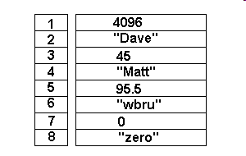
Chapter 0: C++ LANGUAGE
ADDRESS
  For every variable there are two attributes: address and value
In memory with address 3: value: 45.
In memory with address 2: value "Dave"
cout << "Value of 'y' is: " << y << "\n";
cout << "Address of 'y' is: " << &y << "\n\n";

Slide 5
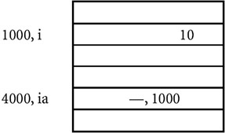
Chapter 0: C++ LANGUAGE
2. POINTERS
  is a variable whose value is also an address.
  A pointer to an integer is a variable that can store the address of that integer
ia: value of variable
&ia: address of ia
*ia means you are printing the value at the location specified by ia

Slide 6
Chapter 0: C++ LANGUAGE
int i; //A
int * ia; //B
cout<<"The address of i "<< &i << " value="<<i <<endl;
cout<<"The address of ia " << &ia << " value = " << ia<< endl;
i = 10; //C
ia = &i; //D
cout<<"after assigning value:"<<endl;
cout<<"The address of i "<< &i << " value="<<i <<endl;
cout<<"The address of ia " << &ia << " value = " << ia<< " point to: "<< *ia;

Slide 7
Chapter 0: C++ LANGUAGE
Points to Remember
  Pointers give a facility to access the value of a variable indirectly.
  You can define a pointer by including a * before the name of the variable.
  You can get the address where a variable is stored by using &.

Slide 8
Chapter 0: C++ LANGUAGE
3. ARRAYS
  An array is a data structure
  used to process multiple elements with the same data type when a number of such elements are known.
  An array is a composite data structure; that means it had to be constructed from basic data types such as array integers.
    int a[5];
    for(int i = 0;i<5;i++)
      {a[i]=i; }

Slide 9
Chapter 0: C++ LANGUAGE
4. ADDRESS OF EACH ELEMENT IN AN ARRAY
  Each element of the array has a memory address.
void printdetail(int a[])
{
for(int i = 0;i<5;i++)
{
cout<< "value in array “<< a[i] <<“ at address: “ << &a[i]);
}

Slide 10
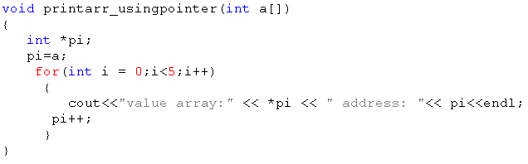
Chapter 0: C++ LANGUAGE
5. ACCESSING & MANIPULATING AN ARRAY USING POINTERS
  You can access an array element by using a pointer.
  If an array stores integers->use a pointer to integer to access array elements.

Slide 11
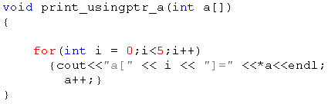
Chapter 0: C++ LANGUAGE
6. ANOTHER CASE OF MANIPULATING AN ARRAY USING POINTERS
  The array limit is a pointer constant : cannot change its value in the program.
It works correctly even using a++ ???
int a[5]; int *b;
a=b; //error
b=a; //OK

Slide 12
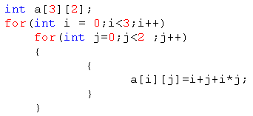

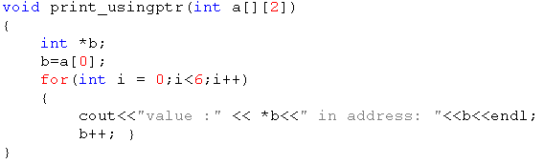
Chapter 0: C++ LANGUAGE
7. TWO-DIMENSIONAL ARRAY
  int a[3][2];

Slide 13
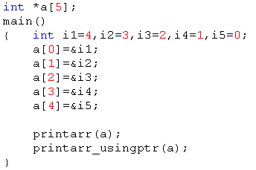
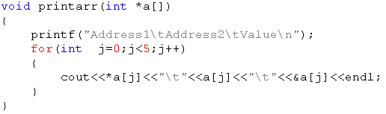
Chapter 0: C++ LANGUAGE
8. POINTER ARRAYS
  You can define a pointer array (similarly to an array of integers).
  In the pointer array, the array elements store the pointer that points to integer values.

Slide 14
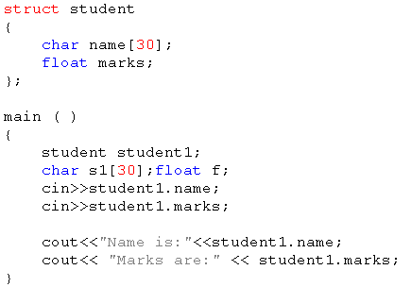
Chapter 0: C++ LANGUAGE
9. STRUCTURES
Structures are used when you want to process data of multiple data types
But you still want to refer to the data as a single entity
Access data: structurename.membername

Slide 15
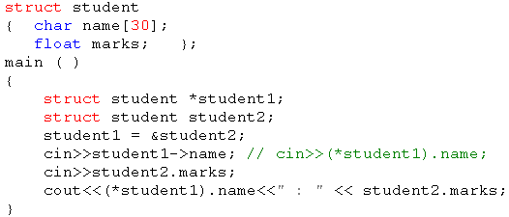
Chapter 1: C++ LANGUAGE
10. STRUCTURE POINTERS
  Process the structure using a structure pointer

Slide 16
CHAPTER 2: FUNCTION & RECURSION
1. FUNCTION
2. THE CONCEPT OF STACK
3. THE SEQUENCE OF EXECUTION DURING A FUNCTION CALL
4. PARAMETER PASSING
5. CALL BY REFERENCE
6. RESOLVING VARIABLE REFERENCES
7. RECURSION
8. STACK OVERHEADS IN RECURSION
9. WRITING A RECURSIVE FUNCTION
10. TYPES OF RECURSION

Slide 17
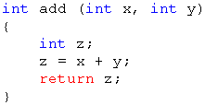
CHAPTER 2: FUNCTION & RECURSION
1. FUNCTION
  provide modularity to the software
  divide complex tasks into small manageable tasks
  avoid duplication of work

Slide 18
Type of Function: return value & parameters
On return value
  Void Functions
  Return Function
    Example: void display(); int max(int a,int b);
On Parameters
  value parameters
  reference parameters
    Exmple: void swap(int &a, int &b); int BinhPhuong(int n);

Slide 19
Week 6: Ôn tập function
Nothing return
void

Slide 20
Week 6: Ôn tập function
Return 1 value
int
  return

Slide 21
Week 6: Ôn tập function
Return many value
void
int
  reference parameters
  On natural way
  return

Slide 22
CHAPTER 2: FUNCTION & RECURSION
3. THE SEQUENCE OF EXECUTION DURING A FUNCTION CALL
  When the function is called, the current execution is temporarily stopped and the control goes to the called function. After the call, the execution resumes from the point at which the execution is stopped.
  To get the exact point at which execution is resumed, the address of the next instruction is stored in the stack. When the function call completes, the address at the top of the stack is taken.

Slide 23
CHAPTER 2: FUNCTION & RECURSION
3. THE SEQUENCE OF EXECUTION DURING A FUNCTION CALL
  Functions or sub-programs are implemented using a stack.
  When a function is called, the address of the next instruction is pushed into the stack.
  When the function is finished, the address for execution is taken by using the pop operation.

Slide 24
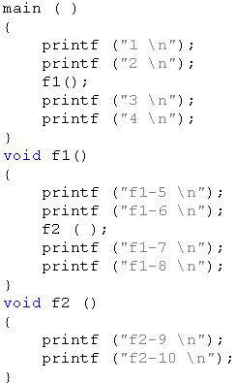
CHAPTER 2: FUNCTION & RECURSION
3. THE SEQUENCE OF EXECUTION DURING A FUNCTION CALL
Result:?

Slide 25
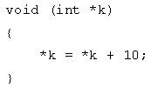
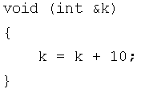
CHAPTER 2: FUNCTION & RECURSION
4. PARAMETER * REFERENCE PASSING
  passing by value
    the value before and after the call remains the same
  passing by reference
    changed value after the function completes

Slide 26
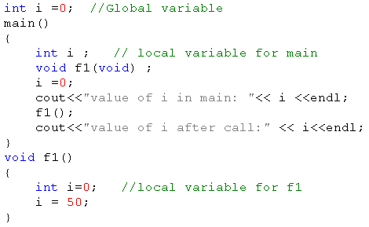
CHAPTER 2: FUNCTION & RECURSION
6. RESOLVING VARIABLE REFERENCES
When a variable can be resolved by using multiple references, the local definition is given more preference

Slide 27
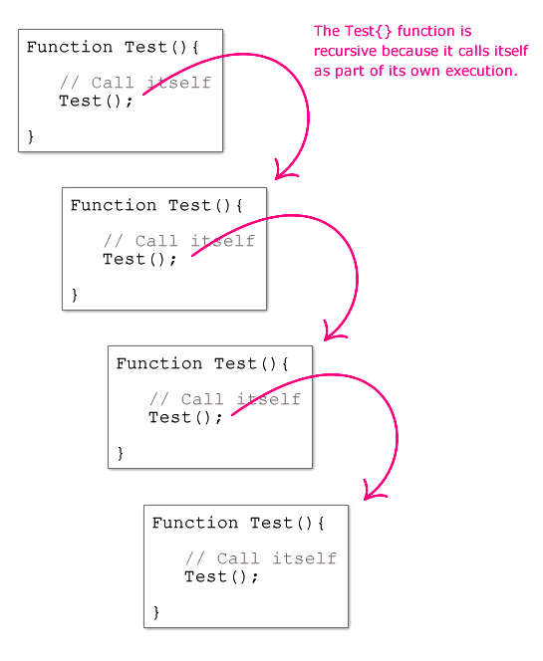
CHAPTER 2: FUNCTION & RECURSION
7. RECURSION
  A method of programming whereby a function directly or indirectly calls itself
  Problems: stop recursion?

Slide 28
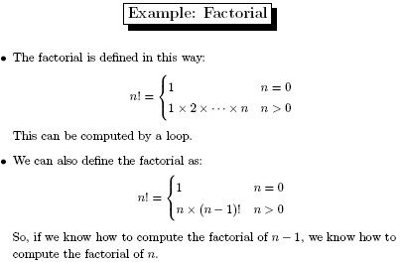
CHAPTER 2: FUNCTION & RECURSION
7. RECURSION

Slide 29
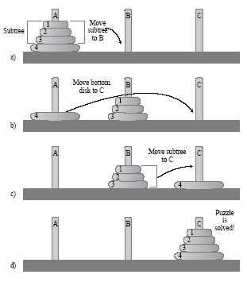
CHAPTER 2: FUNCTION & RECURSION
7. RECURSION: Hanoi tower

Slide 30
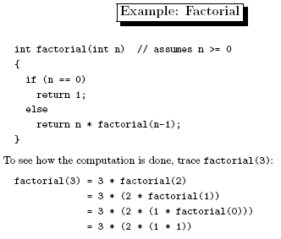
CHAPTER 2: FUNCTION & RECURSION
7. RECURSION

Slide 31
CHAPTER 2: FUNCTION & RECURSION
9. WRITING A RECURSIVE FUNCTION
  Recursion enables us to write a program in a natural way. The speed of a recursive program is slower because of stack overheads.
  In a recursive program you have to specify recursive conditions, terminating conditions, and recursive expressions.

Slide 32
CHAPTER 2: FUNCTION & RECURSION
10. TYPES OF RECURSION
  LINEAR RECURSION
  TAIL RECURSION
  BINARY RECURSION
  EXPONENTIAL RECURSION
  NESTED RECURSION
  MUTUAL RECURSION

Slide 33
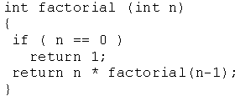
CHAPTER 2: FUNCTION & RECURSION
10. TYPES OF RECURSION
  LINEAR RECURSION
    only makes a single call to itself each time the function runs

Slide 34
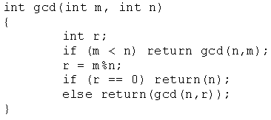
CHAPTER 2: FUNCTION & RECURSION
10. TYPES OF RECURSION
  TAIL RECURSION
    Tail recursion is a form of linear recursion.
    In tail recursion, the recursive call is the last thing the function does. Often, the value of the recursive call is returned.

Slide 35
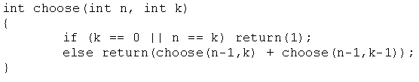
CHAPTER 2: FUNCTION & RECURSION
10. TYPES OF RECURSION
  BINARY RECURSION
    Some recursive functions don't just have one call to themself, they have two (or more).

Slide 36
CHAPTER 2: FUNCTION & RECURSION
10. TYPES OF RECURSION
  EXPONENTIAL RECURSION
    An exponential recursive function is one that, if you were to draw out a representation of all the function calls, would have an exponential number of calls in relation to the size of the data set
    (exponential meaning if there were n elements, there would be O(a^{n}) function calls where a is a positive number)

Slide 37
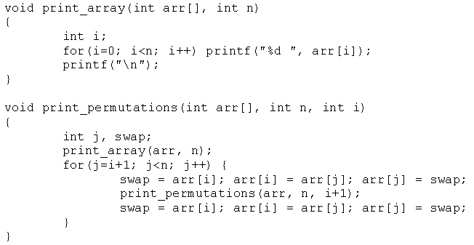
CHAPTER 2: FUNCTION & RECURSION
10. TYPES OF RECURSION
  EXPONENTIAL RECURSION

Slide 38
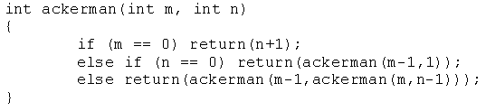
CHAPTER 2: FUNCTION & RECURSION
10. TYPES OF RECURSION
  NESTED RECURSION
    In nested recursion, one of the arguments to the recursive function is the recursive function itself
    These functions tend to grow extremely fast.

Slide 39
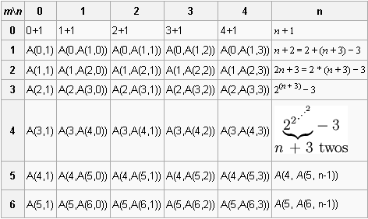

Slide 40
CHAPTER 2: FUNCTION & RECURSION
10. TYPES OF RECURSION
  MUTUAL RECURSION
    A recursive function doesn't necessarily need to call itself.
    Some recursive functions work in pairs or even larger groups. For example, function A calls function B which calls function C which in turn calls function A.

Slide 41
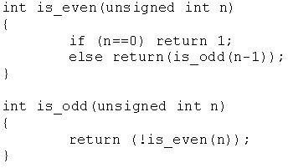
CHAPTER 2: FUNCTION & RECURSION
10. TYPES OF RECURSION
  MUTUAL RECURSION

Slide 42
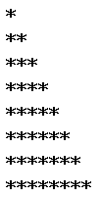
Exercises 1: Recursion

Slide 43
Exercises 2: Recursion
Convert number from H10->H2
7
2
1
3
2
1
1
2
1
0

Slide 44
Week3: Recursion Excercises (1)
E1. (44/174) Write a program to compute: S = 1 + 2 + 3 + …n using recursion.

Slide 45
Week3: Recursion Excercises (2-3)
E3(a). Write a program to print a revert number Example: input n=12345. Print out: 54321.
E3(b). Write a program to print this number Example: input n=12345. Print out: 12345.

Slide 46
Week3: Recursion Excercises (4)
E4. Write a recursion function to find the sum of every number in a int number. Example: n=1980 => Sum=1+9+8+0=18.

Slide 47
Week3: Recursion Excercises (5)
E4. Write a recursion function to calculate:
  S=a[0]+a[1]+…a[n-1]
    A: array of integer numbers

Slide 48
Week3: Recursion Excercises (6)
E4. Write a recursion function to find an element in an array (using linear algorithm)

Slide 49




Week3: Recursion Excercises (7)
Print triangle
c
d
a
b

Slide 50
Week3: Recursion Excercises (8)
Convert number from H₁₀->H₂
7
2
1
3
2
1
1
2
1
0

Slide 51
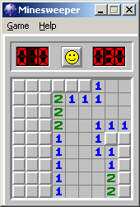

Week3: Recursion Excercises (9)
Minesweeper
Notes:
#include <iostream.h>
#include <conio.h>
#include <stdlib.h>
void nhap(int a[][5],int m,int n);
void xuat(
int a[][5],int m,int n);
void duyet(int a[][5],int m,int n,int x,int y);
int count (int a[][5],int m,int n,int x,int y);
//=======================main ===================================
void main()
{
//randomize();
int a[5][5];
nhap (a,5,5);
xuat(a,5,5);
cout<<"================"<<endl;
int x,y;
cin>>x>>y;
cout<<a[x][y]<<endl;
duyet(a,5,5,x,y);
cout<<"================"<<endl;
xuat(a,5,5);
}
//==============================================================
void duyet(int a[][5],int m,int n,int x,int y)
{
if (a[x][y]!=1) return;
a[x][y]=9;
if (x-1>=0) duyet(a,m,n,x-1,y);
if (x+1<=m-1) duyet(a,m,n,x+1,y);
if (y-1>=0) duyet(a,m,n,x,y-1);
if (y+1<=n-1) duyet(a,m,n,x,y+1);
}
//==============================================================
int count (int a[][5],int m,int n,int x,int y)
{
if (a[x][y]!=1) return 0;
a[x][y]=9;
if (x-1>=0) count(a,m,n,x-1,y);
if (x+1<=m-1) count(a,m,n,x+1,y);
if (y-1>=0) count(a,m,n,x,y-1);
if (y+1<=n-1) count(a,m,n,x,y+1);
}
//===========================nhap mang===============================
void nhap(int a[][5],int m,int n)
{
for (int i=0;i<m;i++)
for (int j=0;j<n;j++)
a[i][j]=rand()%2;
}
//===========================nhap mang===============================
void xuat(int a[][5 ],int m,int n)
{
for (int i=0;i<m;i++)
{
for (int j=0;j<n;j++)
cout<<a[i][j]<<" ";
cout<<endl;
}
}

Slide 52
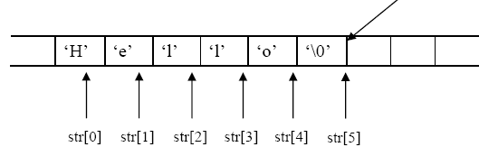
1. String: structure
String
  is array of char
  Ending with null char \0 (size +1)
  Example: store 10 chars:
    char str[11];
  “Example”: string const. C/C++ add \0 automayically

Slide 53
1. String: declare
Declare string
  Using array of chars
    char str[] = {‘H’,’e’,’l’,’l’,’o’,’\0’}; //declare with null
    char str[] = “Hello”; //needn’t null
  Using char pointer
    char *str = “Hello”;

Slide 54
1. String: input
char *gets(char *s);
  Read every char
  Until receive Enter
  Adding Automatically ‘\0’
cin>>s;

Slide 55
1. String: output
int puts(const char *s);
cout<<s;

Slide 56
1. String: Problem with buffer?
Keyboard buffer
    char szKey[] = "aaa";
    char s[10];
    do {
    cout<<"doan lai di?";
    gets(s);
    } while (strcmp (szKey,s) != 0);
    puts ("OK. corect");
If user input: aaaaaaaaaaaaa???

Slide 57
1. String: functions
#include <string.h>
strcpy(s1, s2)
strcat(s1, s2)
strlen(s1)
strcmp(s1, s2) -> (-1,0,1)
strchr(s1, ch)
strstr(s1, s2)

Slide 58
char s1[80], s2[80];
cout << "Input the first string: :";
gets(s1);
cout << "Input the second string: ";
gets(s2);
cout << "Length of s1= " << strlen(s1);
cout << "Length of s2= " << strlen(s2);
if(!strcmp(s1, s2))
cout << "These strings are equal\n";
strcat(s1, s2);
cout << "s1 + s2: " << s1 << endl;;
strcpy(s1, "This is a test.\n");
cout << s1;
if(strchr(s1, 'e')) cout << "e is in " << s1;
if(strstr(s2, "hi")) cout << "found hi in " <<s2;
1. String: function examples

Slide 59
2. File: Creating a new file
#include <io.h>
FILE *fp;
fp=fopen(“d:\\test.txt", "wb"))
fwrite(&Address, sizeof(TYPE), count, fp);
fclose(fp);

Slide 60
2.File: Creating a new file
int Arr[3]
Arr
fwrite(Arr, sizeof(Arr), 1, fp);
Fwrite(Arr, sizeof(int), 1, fp);
for (i=0;i<=3;i++)
Fwrite(&Arr[i], sizeof(int), 1, fp);

Slide 61
2. File: Reading a file
#include <io.h>
FILE *fp;
fp=fopen(“d:\\test.txt", “rb"))
while (fwrite(&Address, sizeof(TYPE), count, fp))
{
  …………….
}
fclose(fp);
Notes:
#include <stdio.h>
#include <iostream.h>
#include <conio.h>
#include <conio.c>
#include <string.h>
#include <io.h>
#include "node.cpp"
void menu()
{
clrscr();
cout<<"1. nhapmoi"<<endl;
cout<<"2. display"<<endl;
cout<<"3. save to d:\a.dat file"<<endl;
cout<<"4. load from d:\a.dat file"<<endl;
cout<<"9. thoat"<<endl;
}
//==========================================
void savefile()
{
FILE *fp;
fp=fopen("d:\\a.dat","wb");
p* t=h;
int count=0;
while (t!=NULL)
{
cout<<t->data<<"...";
fwrite(t, sizeof(p), 1, fp);
count+=1;
t=t->next;
}
cout<<count;
fclose(fp);
}
//================================
void loadfile()
{
FILE *fp;
fp=fopen("d:\\a.dat","rb");
p* t;
h=NULL;
int value;
t=new p();
while (fread(t, sizeof(p), 1, fp))
{
// cout<<t->data<<"...";
t->next=NULL;
cout<<t->data<<"...";
insertatfirst(t);
t=new p();
}
fclose(fp);
}
==============
#include <stdio.h>
#include <iostream.h>
#include <conio.h>
#include <conio.c>
#include <string.h>
//#include "node.cpp"
#include "thuvien1.cpp"
//================================
void main ()
{
while (1)
{
menu();
int tuychon;
cin>>tuychon;
switch (tuychon)
{
case 1:
int value;
cout<<"nbhap sp";
cin>>value;
p* n;
n=createnode(value);
insertatfirst(n);
break;
case 2:
display();
getch();
break;
case 3:
savefile();
getch();
break;
case 4:
loadfile();
getch();
break;
case 9:
exit(0);
}
}
}
==========
#include <stdio.h>
#include <iostream.h>
#include <conio.h>
#include <conio.c>
#include <string.h>
struct p
{
int data;
p* next;
};
p* h;
p* createnode(int v)
{
p* t=new p();
t->data=v;
t->next=NULL;
return t;
}
void insertatfirst(p* n)
{
if (h==NULL)
h=n;
else
{
n->next=h;
h=n;
}
}
//==========================
void display()
{
p* t=h;
while(t!=NULL)
{
cout<<t->data<<" ";
t=t->next;
}
}

Slide 62
CHAPTER 0: INTRODUTION
What is Data Structures?
  A data structure is defined by
    (1) the logical arrangement of data elements, combined with
    (2) the set of operations we need to access the elements.

Slide 63
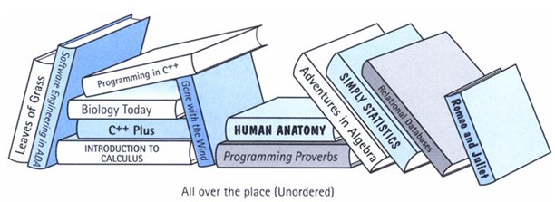
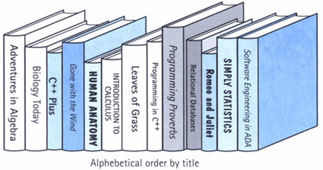
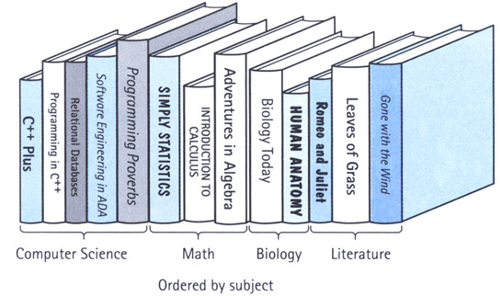
What is Data Structures?
Example:library
  is composed of elements (books)
  Accessing a particular book requires knowledge of the arrangement of the books
  Users access books only through the librarian
the logical arrangement of data elements, combined with
the set of operations we need to access the elements.

Slide 64
Basic Data Structures
Structures include
  linked lists
  Stack, Queue
  binary trees

Slide 65
What is Algorithm?
Algorithm:
  A computable set of steps to achieve a desired result
  Ralationship to Data Structure
    Example: Find an element
2
4
6
1
3
5
7
1
2
3
4
5
6
7

Slide 66

Sumary

Slide 67
SEARCHING TECHNIQUES and Complexity of Algorithm
CHAPTER 3: SEARCHING TECHNIQUES
1. LINEAR (SEQUENTIAL) SEARCH
2. BINARY SEARCH
3. COMPLEXITY OF ALGORITHMS

Slide 68
SEARCHING TECHNIQUES
To finding out whether a particular element is present in the list.
2 methods: linear search, binary search
The method we use depends on how the elements of the list are organized
  unordered list:
    linear search: simple, slow
  an ordered list
    binary search or linear search: complex, faster

Slide 69
1. LINEAR (SEQUENTIAL) SEARCH
How?
  Proceeds by sequentially comparing the key with elements in the list
  Continues until either we find a match or the end of the list is encountered.
  If we find a match, the search terminates successfully by returning the index of the element
  If the end of the list is encountered without a match, the search terminates unsuccessfully.

Slide 70
1. LINEAR (SEQUENTIAL) SEARCH
void lsearch(int list[],int n,int element)
{ int i, flag = 0;
for(i=0;i<n;i++)
if( list[i] == element)
{ cout<<“found at position”<<i);
flag =1;
break; }
if( flag == 0)
cout<<“ not found”;
}
flag: what for???

Slide 71
1. LINEAR (SEQUENTIAL) SEARCH
int lsearch(int list[],int n,int element)
{ int i, find= -1;
for(i=0;i<n;i++)
if( list[i] == element)
{find =i;
break;}
return find;
}
Another way using flag
average time: O(n)

Slide 72
2. BINARY SEARCH
List must be a sorted one
We compare the element with the element placed approximately in the middle of the list
If a match is found, the search terminates successfully.
Otherwise, we continue the search for the key in a similar manner either in the upper half or the lower half.

Slide 73
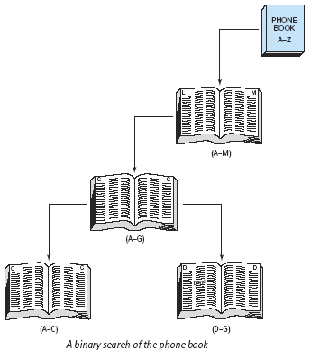
Baba?
Eat?

Slide 74
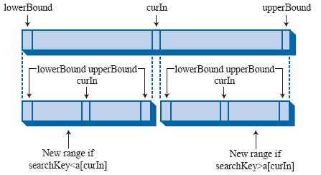

Slide 75
void bsearch(int list[],int n,int element)
{
int l,u,m, flag = 0;
l = 0; u = n-1;
while(l <= u)
{ m = (l+u)/2;
if( list[m] == element)
{cout<<"found:"<<m;
flag =1;
break;}
else
if(list[m] < element)
l = m+1;
else
u = m-1;
}
if( flag == 0)
cout<<"not found";
}
average time: O(log₂n)

Slide 76
BINARY SEARCH: Recursion
int Search (int list[], int key, int left, int right)
{
if (left <= right) {
int middle = (left + right)/2;
if (key == list[middle])
return middle;
else if (key < list[middle])
return Search(list,key,left,middle-1);
else return Search(list,key,middle+1,right);
}
return -1;
}

Slide 77
3. COMPLEXITY OF ALGORITHMS
In Computer Science, it is important to measure the quality of algorithms, especially the specific amount of a certain resource an algorithm needs
Resources: time or memory storage (PDA?)
Different algorithms do same task with a different set of instructions in less or more time, space or effort than other.
The analysis has a strong mathematical background.
The most common way of qualifying an algorithm is the Asymptotic Notation, also called Big O.

Slide 78
3. COMPLEXITY OF ALGORITHMS
It is generally written as
Polynomial time algorithms,
  O(1) --- Constant time --- the time does not change in response to the size of the problem.
  O(n) --- Linear time --- the time grows linearly with the size (n) of the problem.
  O(n²) --- Quadratic time --- the time grows quadratically with the size (n) of the problem. In big O notation, all polynomials with the same degree are equivalent, so O(3n² + 3n + 7) = O(n²)
Sub-linear time algorithms
  O(logn) -- Logarithmic time
Super-polynomial time algorithms
  O(n!)
  O(2^{n})

Slide 79
3. COMPLEXITY OF ALGORITHMS
Example1: complexity of an algorithm
    void f ( int a[], int n )
    {
    int i;
    cout<< "N = “<< n;
    for ( i = 0; i < n; i++ )
    cout<<a[i];
    printf ( "n" );
    }
?
2 * O(1) + O(N)
?
O(N)

Slide 80
3. COMPLEXITY OF ALGORITHMS
Example2: complexity of an algorithm
    void f ( int a[], int n )
    { int i;
    cout<< "N = “<< n;
    for ( i = 0; i < n; i++ )
    for (int j=0;j<n;j++)
    cout<<a[i]<<a[j];
    for ( i = 0; i < n; i++ )
    cout<<a[i];
    printf ( "n" );
    }
?
2 * O(1) + O(N)+O(N²)
?
O(N2)

Slide 81
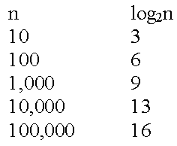
3. COMPLEXITY OF ALGORITHMS
Linear Search
  O(n).
Binary Search
  O(log2 N)

Slide 82
Exercise
Exercise:
  Write a small program
    Input the number of array
    Input array of integer
    Display array
    Input a value. Using linear search to find position of first match item in array
  Using 3 function: enterarray, displayarray,linearfind

Slide 83


SORTING TECHNIQUES
Why?
  Do binary search
  Doing certain operations faster
SORTING

Slide 84
SORTING TECHNIQUES
Given a set (container) of n elements
  E.g. array, set of words, etc.
Suppose there is an order relation that can be set across the elements
Goal Arrange the elements in ascending order
  Start → 1 23 2 56 9 8 10 100
  End → 1 2 8 9 10 23 56 100

Slide 85
SORTING TECHNIQUES
Bubble sort, Insertion sort, Selection sort, Quick sort, Heap sort, Merge sort, Exchange sort …
Focus on
  Bubble sort
  Insertion sort
  Selection sort
  Exchange sort
  Quick sort

Slide 86
SORTING TECHNIQUES
 | Average | Worst
Bubble sort Exchange sort | O(n²) | O(n²)
Insertion sort | O(n²) | O(n²)
Selection sort | O(n²) | O(n²)
Quick sort | O(nlogn) | O(n²)

Slide 87
1.Bubble sort: idea
arrange the elements of the list by forming pairs of adjacent elements.
The pair of the i^{th} and (i+1)^{th} element.
If the order is ascending, we interchange the elements of the pair
This will bring the highest value from among the remaining (n−1) values to the (n−1)th position.

Slide 88
1.Bubble sort: idea
Why it is called Bubble?
3
7
5
2
4
compare 3 and 7 ; 7 is > 3 so advance
3
5
7
2
4
compare 7 and 5, 7 > 5 so swap them
3
5
2
7
4
compare 7 and 2, 7 >4 so swap them
3
5
2
4
7
compare 7 and 4, 7 >4 so swap them
End of pass 1; notice that 7 is in the right place

Slide 89
2.Bubble sort: idea
Simplest sorting algorithm
Idea:
  1. Set flag = false
  2. Traverse the array and compare pairs of two elements
    1.1 If E1 ≤ E2 - OK
    1.2 If E1 > E2 then Switch(E1, E2) and set flag = true
  3. If flag = true goto 1.
What happens?

Slide 90
1.Bubble sort:algorithm idea
void bubbleSort (Array S, length n) {
boolean isSorted = false;
while(!isSorted)
{
isSorted = true;
for(i = 0; i<n; i++)
if(S[i] > S[i+1])
{
swap(S[i],S[i+1];)
isSorted = false;
}
}

Slide 91
1.Bubble sort: implement
void bsort(int list[], int n)
{
int count,j;
for(count=0;count<n-1;count++)
for(j=0;j<n-1-count;j++)
if(list[j] > list[j+1])
swap(list[j],list[j+1]);
}

Slide 92
2. Exchange Sorting
Method : make n-1 passes across the data, on each pass compare adjacent items, swapping as necessary (n-1 compares)
O(n²)

Slide 93
2. Exchange Sorting
void Exchange_sort(int arr[], int n)
{
int i,j;
for(i=0;i<n-1;i++)
for(j=i+1;j<n;j++)
if(arr[i] > arr[j])
swap(arr[i],arr[j]);
}

Slide 94
2. Exchange Sorting
Notes:
  on each successive pass, do one less compare, because the last item from that pass is in place
  if you ever make a pass in which no swap occurs, the sort is complete
  There are some algorithms to improve performance but Big O will remain O(n²)

Slide 95
3. Insertion Sort
Strategy: divide the collection into two lists, one listed with one element (sorted) and the other with the remaining elements.
On successive passes take an item from the unsorted list and insert it into the sorted list so the the sorted list is always sorted
Do this until the unsorted list is empty

Slide 96
3. Insertion Sort
sorted
unsorted
3
7
5
2
4
take an item from the unsorted list (7) and insert into the sorted list
sorted
unsorted
3
7
5
2
4
take next item from the unsorted list (5) and insert into the sorted list
sorted
unsorted
3
5
7
2
4
take next item from the unsorted list (2) and insert into the sorted list
sorted
unsorted
2
3
5
7
4
take next item from the unsorted list (4) and insert into the sorted list
sorted
unsorted
2
3
4
5
7

Slide 97
3. Insertion Sort
void insertionSort(int arr[], int n){
int j, key;
for(int i = 1; i < n; i++){
key = arr[i];
j = i - 1;
while(j >= 0 && arr[j] > key)
{ arr[j + 1] = arr[j];
j = j - 1;
}
arr[j + 1] = key;
}
}

Slide 98
3. Insertion Sort
Note that each insertion could be O(n-1) and there are n-1 insertions being done therefore Big O is O(n²)
This is very much like building an ordered linked list except there is more data movement

Slide 99
4. Selection Sort
Strategy: make a pass across the data looking for the largest item, swap the largest with the last item in the array.
On successive passes (n-1) assume the array is one smaller (the last item is in the correct place) and repeat previous step

Slide 100
biggest
last
4. Selection Sort
3
7
5
2
4
3
4
5
2
7
biggest
last
3
4
5
2
7
3
4
2
5
7
biggest
last
3
4
2
5
7
3
2
4
5
7
3
2
4
5
7
2
3
4
5
7

Slide 101
4. Selection Sort
void selection_sort(int arr[], int n)
{int i, j, min;
for (i = 0; i < n - 1; i++)
{
min = i;
for (j = i+1; j < n; j++)
{ if (list[j] < list[min]) min = j; }
swap(arr[i],arr[min]);
}
}

Slide 102
4. Selection Sort
Notice that in selection sort, there is the least possible data movement
There are still n-1 compares on sublists that become one item smaller on each pass so, Big O is still O(n²)
This method has the best overall performance of the O(n²) algorithms because of the limited amount of data movement

Slide 103
5. Quick Sort
This sorting method by far outshines all of the others for flat out speed
Big O is log₂n
there are problems, worst case performance is when data is already in sorted order or is almost in sorted order (we’ll analyze this separately)
and there are solutions to the problems
and there is an improvement to make it faster still

Slide 104
5. Quick Sort
Sorting algorithms that rely on the “DIVIDE AND CONQUER” paradigm
  One of the most widely used paradigms
  Divide a problem into smaller sub problems, solve the sub problems, and combine the solutions
  Learned from real life ways of solving problems

Slide 105
5. Quick Sort
Another divide-and-conquer sorting algorihm
To understand quick-sort, let’s look at a high-level description of the algorithm
1) Divide : If the sequence S has 2 or more elements, select an element x from S to be your pivot. Any arbitrary element, like the last, will do. Remove all the elements of S and divide them into 3 sequences:
  L, holds S’s elements less than x
  E, holds S’s elements equal to x
  G, holds S’s elements greater than x
2) Recurse: Recursively sort L and G
3) Conquer: Finally, to put elements back into S in order, first inserts the elements of L, then those of E, and those of G.

Slide 106
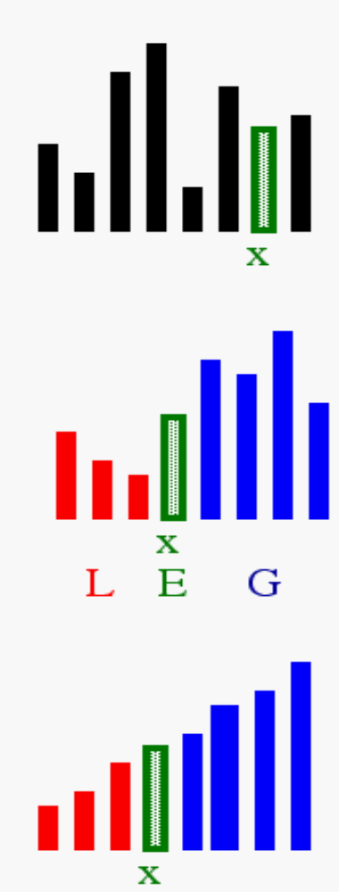
5. Quick Sort: idea
1) Select: pick an element
2) Divide: rearrange elements so that x goes to its final position E
3) Recurse and Conquer: recursively sort

Slide 107
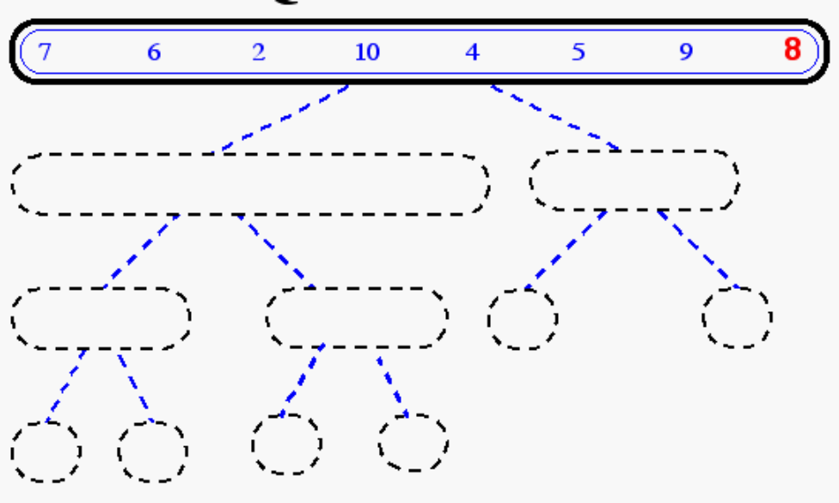
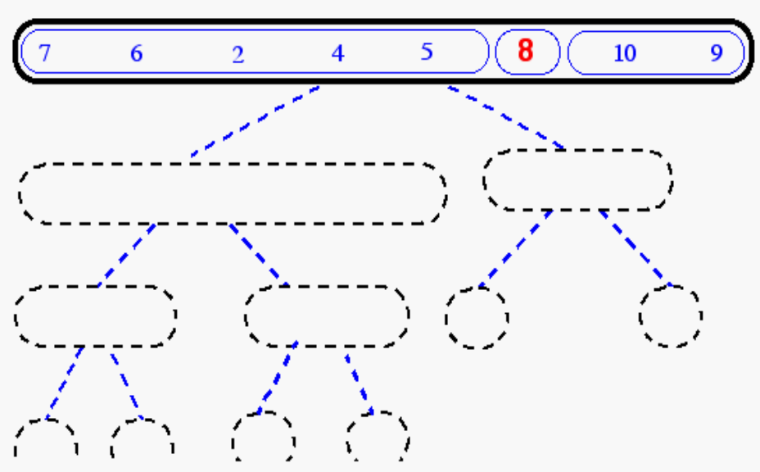
5. Quick Sort: idea

Slide 108
Quick Sort
Pick the leftmost element as the pivot (23). Now , start two cursors (one at either end) going towards the middle and swap values that are > pivot (found with left cursor) with values < pivot (found with right cursor)
23
17
5
12
19
24
4
43
34
11
3
33
14
26
8
27
swap
23
17
5
12
19
8
4
43
34
11
3
33
14
26
24
27
swap
23
17
5
12
19
8
4
14
34
11
3
33
43
26
24
27
swap
23
17
5
12
19
8
4
14
3
11
34
33
43
26
24
27
swap
Finally, swap the pivot and the value where the cursors passed each other
11
17
5
12
19
8
4
14
3
23
34
33
43
26
24
27
Note : 23 is now in the right place and everything to its left is < 23 and everything to its right is > 23

Slide 109
Quick Sort
Now, repeat the process for the right partition
11
17
5
12
19
8
4
14
3
23
34
33
43
26
24
27
swap
11
17
5
12
19
8
4
14
3
swap
11
3
5
4
19
8
12
14
17
swap
11
3
5
4
8
19
12
14
17
swap
8
3
5
4
11
19
12
14
17
Note: the 11 is now in the right place, and the left partition is all < pivot and the right partition is all > pivot

Slide 110
Quick Sort (worst case)
If the data is already sorted watch what happens to the partitions
3
4
5
8
11
12
14
17
19
23
24
26
27
33
34
43
There is nothing to swap
4
5
8
11
12
14
17
19
23
24
26
27
33
34
43
Again, nothing to swap…..
The partitions are always the maximum size and the performance degrades to O(n²)

Slide 111
Quick Sort
void quickSort(int Arr[], int lower, int upper)
{
int x = Arr[(lower + upper) / 2];
int i = lower; int j = upper;
do{
while(Arr[i] < x) i ++;
while (Arr[j] > x) j --;
if (i <= j)
{
swap(Arr[i], Arr[j]);
i ++; j --; }
}while(i <= j);
if (j > lower)
quickSort(Arr, lower, j);
if (i < upper)
quickSort(Arr, i, upper);
}

Slide 112
STACKS AND QUEUES
STACKS: concept
QUEUES : concept
STACKS,QUEUES : implement
  Using array
  Using Linked List (next chapter)

Slide 113
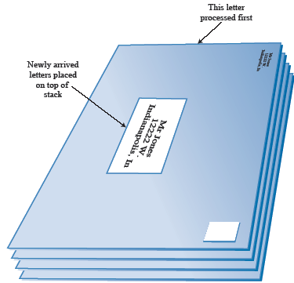
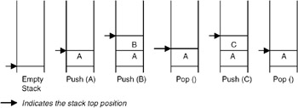
1.Stack
LIFO (last in first out)

Slide 114
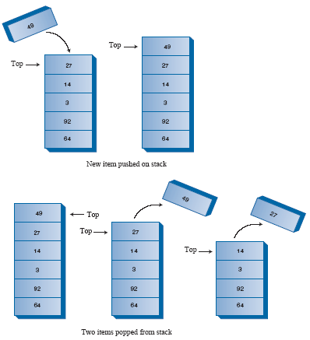
1.Stack
Managing Top element

Slide 115
1.Stack: implement using array
#define MAX 10
void main()
{
int stack[MAX];
int top = -1;
push(stack,top, 10 );
pop(stack,top,value);
int value;
cout<<value;
}

Slide 116
1.Stack: implement using array
void push(int stack[], int &top, int value)
{
if(top < MAX )
{
top = top + 1;
stack[top] = value;
}
else
cout<<"The stack is full";
}

Slide 117
1.Stack: implement using array
void pop(int stack[], int &top, int &value)
{
if(top >= 0 )
{
value = stack[top];
top = top - 1;
}
else
cout<<"The stack is empty ";
}

Slide 118
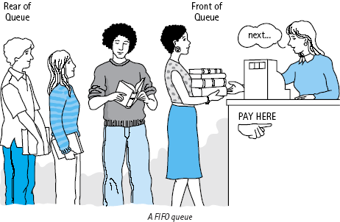
2.QUEUE
FIFO (first in first out)

Slide 119
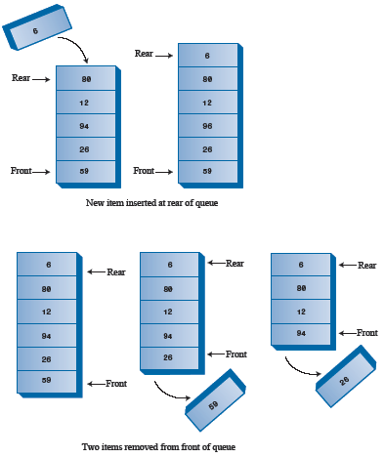
2.QUEUE: implement using array
A circular queue

Slide 120
2.QUEUE: implement using array
#define MAX 10
void main()
{
int queue[MAX];
int bottom,top,count=0;
bottom=top=-1;
enqueue(queue,count,top, 100 );
int value;
dequeue(queue,count,bottom,top,value);
}

Slide 121
2.QUEUE: implement using array
void enqueue(int queue[],int &count, int &top, int value)
{
if(count< MAX)
{
count++;
top= (top +1)%MAX;
queue[top] = value;
}
else
cout<<"The queue is full";
}

Slide 122
2.QUEUE: implement using array
void dequeue(int queue[], int &count,int &bottom,int top, int &value)
{
if(count==0)
{
cout<<"The queue is empty";
exit(0);
}
bottom = (bottom + 1)%MAX;
value = queue[bottom];
count--;
}

Slide 123
3. Application of stack, queue
Stack: Expression evaluation
  a*(b–c)/d => abc–*d/
Queue: priority queues

Slide 124
Exercise:
Implement: 5 sort algorithms
Implement stack, queue using array
  Menu with 4 choices
    Add, remove, display, exit

Slide 125
Linked List
THE CONCEPT OF THE LINKED LIST
SINGLE LINKED LIST
DOUBLE LINKED LIST
CIRCULAR LINKED LIST

Slide 126
THE CONCEPT OF THE LINKED LIST
the size requirement need not be known at compile time
A linked list is a data structure that is used to model such a dynamic list of data items, so the study of the linked lists as one of the data structures is important.

Slide 127
Array and LINKED LIST
ARRAY
  sequential mapping, elements are fixed distance apart
  makes insertion or deletion at any arbitrary position in an array a costly operation
Linked List
  not necessary that the elements be at a fixed distance apart
  an element is required to be linked with a previous element of the list
  done by storing the address of the next element

Slide 128
Array and LINKED LIST
Array: max length=7
0
1
2
3
4
5
6
X
X
X
X
0
1
2
3
4
5
6
Get element by order number
Linked List: max length=18
0
1
2
3
4
5
6
X
7
8
9
X
10
11
X
12
13
14
X
15
16
17
18

Slide 129
Type of Linked List
1
data
Link
data
Link
NULL
data
Link
data
Link
2
Link
Link
3
data
data
Link
Link
data
Link
Link
4
data
data
Link
Link
Link
Link

Slide 130
4 things when building Linked List
1. Structure
  Data element
  Link field element
2. The way to make link between elements
  First, last, middle element
3. How many node to take all list elements, how to take all list
4. Basic operations:
  Insert new element (every position)
  Delete (every position)
  Find
  Notes: Check value change in step 3

Slide 131
2.Singly Linked List
data
Link
data
Link
NULL
1. Structure
  Data element
  Link field element
2. The way to make link between elements
  First, last, middle element
3. How many node to take all list elements , how to take all list
4. Basic operations:
  Insert new element (every location)
  Delete (every position)
  Find

Slide 132

2.Singly Linked List
1. Structure
struct Node
{
int data;
Node *link;
};

Slide 133
2.Singly Linked List
1. Structure: how to use one node
Node a;
a.data=10;
a.link=NULL;
cout<<a.data;
Node *b;
b=new Node;
b->data=20;
b->link=NULL;
cout<<b->data;
delete b;
Compare??? What is the different? Delele and change address

Slide 134
2.Singly Linked List
2. The way to make link between elements
  First, last, middle element
data
Link
data
Link
data
Link
data
Link
NULL
Head
Middle
Last

Slide 135
2.Singly Linked List
pTail
3. How many node to take all list elements, how to take all list
data
Link
data
Link
data
Link
data
Link
NULL
Why
+from pHead, can we list all items?
+from pHead, can we do everything with list: insert new, delete?
+Do we need pTail?
pHead

Slide 136
2.Singly Linked List
3. How many node to take all list elements, how to take all list
pTail
data
Link
data
Link
data
Link
data
Link
NULL
How to store pHead, pTail
pHead
Type 1: Node *pHead=NULL, *pTail=NULL;
Type 2: typedef struct Node *List;
List pHead, pTail;
Notes:
#include <iostream.h>
typedef struct Node *List;
struct Node
{
int data;
Node *link;
};
void change(List &a)
{
a=new Node();
cout<<"trong than ham:" <<a<<endl;
}
void main()
{
List a=new Node();
a->data=10;
a->link=NULL;
cout<<"truoc khi goi ham:"<<a<<endl;
change (a);
cout<<"sau khi goi ham:"<<a<<endl;
delete a;
}

Slide 137
2.Singly Linked List
4. Basic operations:
p
data
Link
data
Link
data
Link
NULL
Remove node
Insert node
creating new node

Slide 138
2.Singly Linked List
4. Basic operations: creating new node
Node * createNewNode(int X)
{
Node *p=new Node;
If (p!=NULL)
{
p->data=X;
p->link=NULL;
}
return p;
}
p
data
Link
NULL

Slide 139
2.Singly Linked List: using Phead only
void addnodeatFirst(node *newnode)
{
if (pHead==NULL)
{
pHead =newnode;
}
else
{
newnode->next=pHead;
pHead =newnode;
}
}
Insert Node at First
Notes:
#include <iostream.h>
#include <conio.h>
#include <conio.c>
void menu();
struct node
{
int data;
node *next;
};
node *h=NULL;
void removeatlast()
{
node *t=h;
node *truoc=t;
while (t->next!=NULL)
{
truoc=t;
t=t->next;
}
truoc->next=NULL;
delete t;
}
void insertatlast(node *newnode)
{
node *t=h;
while (t->next!=NULL)
t=t->next;
t->next=newnode;
}
//============================
node *find(int data)
{
node *temp=h;
while (temp!=NULL && temp->data!=data)
temp=temp->next;
return temp;
}
//===========================
void xoanodedau()
{
if (h!=NULL)
{
node *t=h;
h=h->next;
delete t;
}
}
//============================
node* taonode(int data)
{
node *n=new node();
if (n!=NULL)
{
n->data=data;
n->next=NULL;
}
return n;
}
//==================================
void addnode(node *newnode)
{
if (h==NULL)
{
h=newnode;
}
else
{
newnode->next=h;
h=newnode;
}
}
//===================================
void displaylist()
{
node *temp=h;
while (temp!=NULL)
{
cout<<temp->data<<" ";
temp=temp->next;
}
}
void main()
{
while(1)
{
menu();
int l;
cin>>l;
switch (l)
{
case 1:
int k;
cout<<"nhap so:";
cin>>k;
node* X;
X=taonode(k);
addnode(X);
break;
// case 2:
// break;
case 3:
displaylist();
getch();
break;
case 4:
xoanodedau();
break;
case 5:
node* X1;
int f;cout<<"nhap so can tim:";cin>>f;
X1=find(f);
if (X1==NULL)
cout<<"khong thay";
else
cout<<"tium thay";
getch();
break;
case 6:
removeatlast();
break;
case 7:
cout<<"nhap so:";
cin>>k;
X=taonode(k);
insertatlast(X);
break;
case 9:
exit(0);
}
}
}
void menu()
{
clrscr();
cout<<"1.them dau"<<endl;
cout<<"2.them cuoi"<<endl;
cout<<"3.Xuat"<<endl;
cout<<"4.Xoa node dau"<<endl;
cout<<"5.Find"<<endl;
cout<<"6.remove at last"<<endl;
cout<<"7.Insert at Last"<<endl;
cout<<"9.Thoat"<<endl;
}

Slide 140
2.Singly Linked List: using Phead only
void displaylist()
{
node *temp=h;
while (temp!=NULL)
{
cout<<temp->data<<" ";
temp=temp->next;
}
}
Seek Nodes

Slide 141
2.Singly Linked List: using Phead only
void RemoveNodeatFirst()
{
if (pHead!=NULL)
{
node *t= pHead;
pHead = pHead ->next;
delete t;
}
}
Remove Node at First

Slide 142
2.Singly Linked List: using Phead only
node *find(int key)
{
node *temp=h;
while (temp!=NULL && temp->data!=key)
temp=temp->next;
return temp;
}
Find Node

Slide 143
2.Singly Linked List: using Phead only
void removeatlast()
{
node *t=h;
node *truoc=t;
while (t->next!=NULL)
{
truoc=t;
t=t->next;
}
truoc->next=NULL;
delete t;
}
Remove Node at Last

Slide 144
2.Singly Linked List: using Phead only
void insertatlast(node *newnode)
{
node *t=h;
while (t->next!=NULL)
t=t->next;
t->next=newnode;
}
Insert Node at Last

Slide 145
2.Singly Linked List:using pHead & pTail
4. Basic operations: Insert new node
pHead
pTail
data
Link
data
Link
data
Link
NULL
data
Link

Slide 146
2.Singly Linked List
4. Basic operations: Insert new node at First
void Insert_First (node *newnode)
{ if ( pTail == NULL )
{
pHead=pTail =newnode ;
}
else
{
newnode->next=pHead ;
pHead=newnode;
}
}

Slide 147
2.Singly Linked List
4. Basic operations: Insert new node at Last
void Insert_Last (node *newnode)
{ if ( pTail == NULL )
{
pHead=pTail =newnode ;
}
else
{
pTail>next=newnode ;
pTail=newnode;
}
}

Slide 148
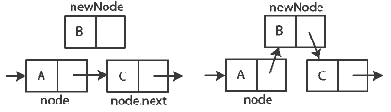
2.Singly Linked List
4. Basic operations: Insert new node after node
void Insert_after (node *newnode,node *p)
{
If (p!=pTail)
{
newnode->next=p>next;
p->next=newnode;
}
else
insert_Last (newnode);
}

Slide 149
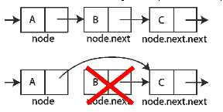
2.Singly Linked List
4. Basic operations: remove node at First
void removeNodeAtFirst ()
{
If (pHead!=NULL)
{
Node *temp=pHead;
pHead = pHead >next;
delete temp;
}
}

Slide 150
2.Singly Linked List
4. Basic operations: remove node after
void removeNodeAfter (node *p)
{
Node *temp=p>next;
p->next=p->next->next;
delete temp;
}

Slide 151
2.Singly Linked List
4. Basic operations: remove node at Last
void removeNodeatLast ()
{
???
}

Slide 152
2.Singly Linked List
4. Basic operations: Seek all nodes
Void Display()
{
node *p=pHead;
while (p!=NULL)
{
cout<<p->data<<“ “;
p=p->next;
}
}

Slide 153
2.Singly Linked List
4. Basic operations: count number of nodes
int Count ()
{
int count=0;
node *p=pHead;
while (p!=NULL)
{
count+=1;
p=p->next;
}
return count;
}

Slide 154
2.Singly Linked List
4. Basic operations: Remove List
Remove pHead node
Do until pHead is NULL

Slide 155
2.Singly Linked List: Demo
Write a program for buiding single linked list: using pHead only
  Display menu
    Add one node at first
    Add one node at last
    Add many node at first
    Add many node at last
    Select and display n(th) node
    Find one node
    Add one node after select node
    Display node count
    Display List
    Remove one node
    Remove List
    Get sum of all nodes

Slide 156
Cont…
Find node
Single linked list: pHead and pTail
Circular single linked list
Double Linked List

Slide 157
Find Node
Using While
Using Loop

Slide 158
Find Node: using while loop
Node* temp; //Node *temp=new Node();???
temp=pHead;
while (temp->data!=Xvalue)
temp=temp->next;
=========================================
Node* temp; //Node *temp=new Node();???
temp=pHead;
while (temp!=NULL && temp->data!=Xvalue)
temp=temp->next;
Exactly
May be not found

Slide 159
Find Node: using for loop
for (Node* temp=pHead;temp->data!=Xvalue; temp=temp->next);

Slide 160
3.Singly Linked List: pHead and pTail
Same to manage list with pHead
Take care: cases change pTail
  Add node
  Remove Node

Slide 161
3.Singly Linked List: pHead and pTail
When pTail is changed?
  Insert new node at first
pHead =
pTail=NULL
pHead=
pTail
How to check ?
data
Link
pHead
pTail
data
Link
data
Link

Slide 162
3.Singly Linked List: pHead and pTail
When pTail is changed?
  Insert new node at Last
pHead =
pTail=NULL
pHead=
pTail
How to check ?
data
Link
pHead
pTail
data
Link
data
Link

Slide 163
3.Singly Linked List: pHead and pTail
When pTail is changed?
  Insert new node after one node
pHead =
pTail=NULL
pHead=
pTail
How to check ?
data
Link
pHead
pTail
data
Link
data
Link
data
Link

Slide 164
3.Singly Linked List: pHead and pTail
When pTail is changed?
  Remove node
pHead =
pTail=NULL
pHead=
pTail
How to check ?
data
Link
pHead
pTail
data
Link
data
Link
data
Link

Slide 165
3.Singly Linked List: pHead and pTail
Example:
  Write function to insert at last
  Single linked list with pHead and pTail

Slide 166

4. Circular single linked list
Circular
  Last node point to first node
  Draw like Circle
When using Circular single linked list
  Every node in list had the same position
  Needn’t Head, Tail

Slide 167
4. Circular single linked list
Control Circular single linked list: Insert node
pHead =NULL
pHead
How to check ?
data
Link
pHead
data
Link
data
Link
data
Link

Slide 168
4. Circular single linked list
Control Circular single linked list: Insert node steps
pHead
data
Link
data
Link
data
Link
data
Link
data
Link
data
Link
data
Link
data
Link
data
Link
data
Link
data
Link
data
Link

Slide 169
4. Circular single linked list
Control Circular single linked list: Remove node
pHead =NULL
pHead
How to check ?
data
Link
pHead
data
Link
data
Link
data
Link

Slide 170
4. Circular single linked list
Example:
  Write function to remove a node
  Circular single linked list with pHead and pTail

Slide 171

4. Double Linked List
Struct Node
{
  Int data;
  Node *next;
  Node * pre;
};

Slide 172
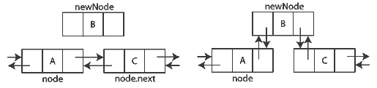
4. Double Linked List
Insert new node
  First, Last, after node
Remove node
  First,Last, at one middle node

Slide 173
4. Double Linked List
Insert new node: after one Node First steps
data
data
data
data
data
data
data
data
data
data
data
data

Slide 174
4. Double Linked List
Remove node: steps
data
data
data
data
data
data
data
data
data
data
data
data

Slide 175
4. Double Linked List
Example
  Write function to remove first node (pHead)
  Write function to insert a node after another node

Slide 176
Tree
1. THE CONCEPT OF TREES
2. BINARY TREE AND REPRESENTATION
3. BINARY TREE TRAVERSAL
4. BINARY SEARCH TREE
<
6
2
>
9
1
4
=
8

Slide 177
1. THE CONCEPT OF TREES
A tree is a set of one or more nodes T:
  there is a specially designated node called a root
  The remaining nodes are partitioned into n disjointed set of nodes T1, T2,…,Tn, each of which is a tree.

Slide 178
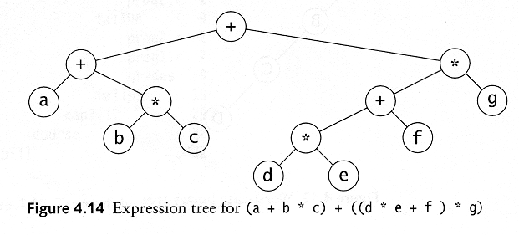
1. THE CONCEPT OF TREES
Example

Slide 179
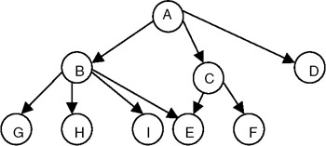
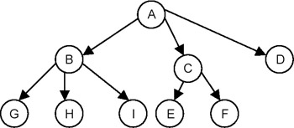
1. THE CONCEPT OF TREES
It’s not a tree
Tree

Slide 180

1. THE CONCEPT OF TREES: Some terminology
Root
Child (left,right)
Parent
Leaf node
Subtree
Ancestor of a node
Descendant of a node

Slide 181

1. THE CONCEPT OF TREES
Degree of a Node of a Tree
  The degree of a node of a tree is the number of subtrees having this node as a root.
Degree of a Tree
  The degree of a tree is defined as the maximum of degree of the nodes of the tree
Level of a Node
  level of the root node as 1, and incrementing it by 1 as we move from the root towards the subtrees.

Slide 182
2. BINARY TREE AND REPRESENTATION
BINARY TREE
  no node can have a degree of more than 2.
  The maximum number of nodes at level i will be 2^{i}−1
  If k is the depth of the tree then the maximum number of nodes that the tree can have is
  2^{k} − 1 = 2^{k−1} + 2^{k−2} + … + 2⁰

Slide 183

2. BINARY TREE AND REPRESENTATION
BINARY TREE
  A full binary tree is a binary of depth k having 2^{k} − 1 nodes.
  If it has < 2^{k} − 1, it is not a full binary tree

Slide 184

What is the height h of a full tree with N nodes?
The max height of a tree with N nodes is N (same as a linked list)
The min height of a tree with N nodes is log(N+1)

Slide 185


Slide 186
2. BINARY TREE AND REPRESENTATION
full binary
3=2²-1
7=2³-1
15=2⁴-1

Slide 187


2. BINARY TREE AND REPRESENTATION
struct node
  { int data;
  node *left;
  node *right;
  };

Slide 188
Tree traversal
Used to print out the data in a tree in a certain order
  inorder (LDR )
  Postorder (LRD )
  preorder (DLR )
Pre-order traversal
  Print the data at the root
  Recursively print out all data in the left subtree
  Recursively print out all data in the right subtree

Slide 189
Preorder, Postorder and Inorder
Preorder traversal
  node, left, right
  prefix expression
    ++a*bc*+*defg

Slide 190
Preorder, Postorder and Inorder
Postorder traversal
  left, right, node
  postfix expression
    abc*+de*f+g*+
Inorder traversal
  left, node, right.
  infix expression
    a+b*c+d*e+f*g

Slide 191



Preorder, Postorder and Inorder

Slide 192


3. BINARY TREE TRAVERSAL

Slide 193

3. BINARY TREE TRAVERSAL
Inorder = DBEAC
Many trees

Slide 194
4. BINARY SEARCH TREE
A binary search tree
  is a binary tree (may be empty)
  every node must contain an identifier.
  An identifier of any node in the left subtree is less than the identifier of the root.
  An identifier of any node in the right subtree is greater than the identifier of the root.
  Both the left subtree and right subtree are binary search trees.

Slide 195


Slide 196

4. BINARY SEARCH TREE
binary search tree.

Slide 197

Binary Search Trees
A binary search tree
Not a binary search tree

Slide 198

Binary search trees
Two binary search trees representing
the same set: Why?

Slide 199
Performance
Consider a dictionary with n items implemented by means of a binary search tree of height h
  the space used is O(n)
  methods find, insert and remove take O(h) time
The height h is O(n) in the worst case and O(log n) in the best case

Slide 200
4. BINARY SEARCH TREE
Why using binary search tree
  traverse in inorder: sorted list
  searching becomes faster
But..
  Insert, delete: slow
Important thing: Index in Database system
  Using the right way of Index property

Slide 201
Search
Algorithm TreeSearch(k, v)
if (v ==NULL)
  return v
  if k < key(v)
  return TreeSearch(k, T.left(v))
  else if k = key(v)
  return v
  else { k > key(v) }
  return TreeSearch(k, T.right(v))
To search for a key k, we trace a downward path starting at the root
The next node visited depends on the outcome of the comparison of k with the key of the current node
If we reach a leaf, the key is not found and we return nukk
Example: find(4):
  Call TreeSearch(4,root)
<
6
2
>
9
1
4
=
8

Slide 202
Insertion
To perform operation inser(k, o), we search for key k (using TreeSearch)
Assume k is not already in the tree, and let let w be the leaf reached by the search
We insert k at node w and expand w into an internal node
Example: insert 5
<
6
2
>
9
1
4
>
8
w
6
2
9
1
4
8
w
5

Slide 203

4. BINARY SEARCH TREE
Insert new node

Slide 204


Slide 205
4. BINARY SEARCH TREE
Insert new node
void InsertNode(node* &root,node *newnode)
{
if (root==NULL)
root=newnode;
else
if (root->data>newnode->data)
InsertNode(root->l,newnode);
else
if (root->data<newnode->data)
InsertNode(root->r,newnode);
}

Slide 206

Insert node

Slide 207

Insert node

Slide 208

Insert Order

Slide 209
4. BINARY SEARCH TREE
traverse node
  void preorder(node* r)
  {
  if (r!=NULL)
  { cout<<r->data<<" ";
  inorder(r->l);
  inorder(r->r);
  }
  }

Slide 210

4. BINARY SEARCH TREE
traverse node

Slide 211

4. BINARY SEARCH TREE
traverse node

Slide 212
Exercise 1
1. Build Binary Search Tree from list
  10 4 7 12 16 20 30 5 2 26 15
  24 12 89 4 32 50 10 6 36 79 5 9 11

Slide 213

Exercise 2
1. Order of: inoder, postorder, preorder of

Slide 215

Exercise 3
1. Order of: inoder, postorder, preorder of

Slide 216
Week 10
Search node
Count
  Even/Odd
  Leaf
Sum
  Even/Odd
Height
Delete node

Slide 217
1. SEACRCHING NODE
node* search(node* &r, int data)
{
if (r==NULL)
return NULL;
else
if (r->data==data)
return r;
else
if (data<r->data)
return search (r->l,data);
else
if (data>r->data)
return seach(r->r,data);
}

Slide 218



Slide 219
1. SEACRCHING NODE
H3
100
node* search(node* &r, int data)
{
if ( (r==NULL) || (r->data==data) )
return r;
else
if (data<r->data)
return search (r->l,data);
else
if (data>r->data)
return seach(r->r,data);
}
H20
H40
H20
H40
80
120
NULL
NULL
NULL
NULL
Node* S=search(r,80)
What does S stand for?

Slide 220
2. COUNTING THE NUMBER OF NODES
int count(struct tnode *p)
{
if( p == NULL)
return(0);
else
if( p->lchild == NULL && p->rchild == NULL)
return(1);
else
return(1 + (count(p->lchild) + count(p->rchild)));
}
Without Recursion
With Recursion

Slide 221
2. COUNTING THE NUMBER OF NODES
int count(struct tnode *p)
{
if( p == NULL)
return(0);
else
return(1 + (count(p->lchild) + count(p->rchild)));
}

Slide 222
3. Sum of all nodes
int sum(node *p)
{
if( p == NULL)
return(0);
else
return( p->data+sum(p->l)+sum(p->r) );
}

Slide 223
4. COUNTING THE NUMBER OF EVEN (ODD) NODES
int counteven(node* r)
{
if (r!=NULL)
if (r->data%2==0)
return 1+ counteven(r->l)+counteven(r->r);
else
return counteven(r->l)+counteven(r->r);
else
return 0;
}

Slide 224
5. SUM OF EVEN (ODD) NODES
int counteven(node* r)
{
if (r!=NULL)
if (r->data%2==0)
????????????????????
else
????????????????????
else
return 0;
}

Slide 225
6. Count number of leaf nodes
Exercise
  Count number of leaf nodes

Slide 226
6. Count number of leaf nodes
int countleaf(node* r)
{
if (r!=NULL)
if (r->l==NULL && r->r==NULL)
return 1;
else
return countleaf(r->l)+countleaf(r->r);
else
return 0;
}

Slide 227
6. Count number of node had 1 child
int count1child(node* r)
{
if (r!=NULL)
if (????????????????????????????)
return 1+count1child(r->l)+count1child(r->r);
else
return count1child(r->l)+count1child(r->r);
else
return 0;
}

Slide 228
6. Count number of node had 2 children
int count2child(node* r)
{
if (r!=NULL)
if (????????????????????????)
return 1+count2child(r->l)+count2child(r->r);
else
return count2child(r->l)+count2child(r->r);
else
return 0;
}

Slide 229
7. Find height of tree
int Height (node* n)
{
if(n==NULL) return 0;
else return 1+max(Height (n->l)),
Height (n->r));
}

Slide 230

8. Delete node
Divide into 3 cases
  Deletion of a Node with No Child
  Deletion of a Node with one Child
  Deletion of a Node with two Children
Notes:
void del(node* &n)
{
if (n->l==NULL)
{
node* temp=n;
n=n->r;
delete temp;
}
else if(n->r==NULL)
{
cout<<"n->r==NULL";
node* temp=n;
n=n->l;
delete temp;
}
else
{
node *temp=n->r;
node*parent=n;
while (temp->l!=NULL)
{
parent=temp;
temp=temp->l;
}
n->data=temp->data;
if (temp==parent->l)
del(parent->l);
else
del(parent->r);
}
}
void del1(node* &n,int tim)
{
if (n==NULL) return;
if (n->data<tim)
del1(n->r,tim);
else if (n->data>tim)
del1(n->l,tim);
else //bang
del(n);
}

Slide 231


8. Delete node
Deletion of a Node with No Child
  Set the left of y to NULL
  Dispose of the node pointed to by x

